Slide 1


Bureau of Voting Systems Certification
FLORIDA
DEPARTMENT
of STATE
Overview
FSE New Supervisor of Elections
Orientation Workshop
February 5, 2025 (Tallahassee)

Slide 2
BVSC Structure

Slide 3
BVSC Organizational Chart
Chief
Senior Management Analyst II
Systems Programmer III
Systems Project Consultant
Regulatory Specialist III
Computer Audit Analyst
Distributed Computer Systems Consultant
Computer Audit Analyst
Administrative Assistant II

Slide 4
Bureau of Voting Systems Certification
Test voting systems & voting process (periphery) items – automated independent audit, independent recount tabulation system, etc.
Develop test standards & review new technology as required
Conduct election observations –routine/official
Provide technical assistance
Maintain online local elections dates database
Conduct bi-ennial review and year-round updates – county minimum security procedures
Review, update & provide technical assistance for rules
Track & maintain county voting systems/equipment info
Collect and analyze various post-election reports – conduct of elections, overvote/undervote, post-election voting system audit, precinct-level election results

Slide 5
Voting Systems Certification Process
Summary

Slide 6
Voting System - Components
A voting system consists of all of the components necessary to cast, process, and tabulate votes. At minimum,
  A vote tabulator that scans/records paper ballots
  An ADA device,
  An election management system.
  A high-speed (central count) scanner (optional).

Slide 7
Process
Vendor
Submits Form DS-DE 71, additional items and documentation, and source code (this is the “technical data package” or TDP) and registered agent info
BVSC
Reviews submission(s) and if/when complies with requirements, prepares and executes a test plan
Examines the system for statutory compliance, functionality, durability, usability, etc.
Prepares test report
Secretary of State
If recommendation adopted, a certificate is issued
BVSC
Notifies vendor and SOEs
Installation process initiated once SOEs purchase new equipment or upgrade
Formalizes recommendation to approve or not for Division Director or approval as applicable

Slide 8
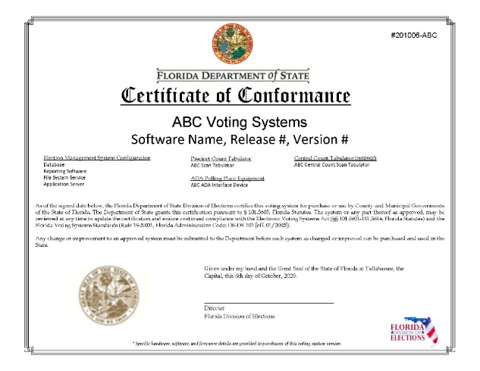
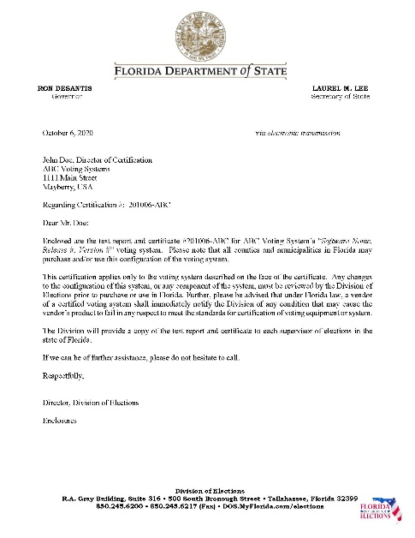
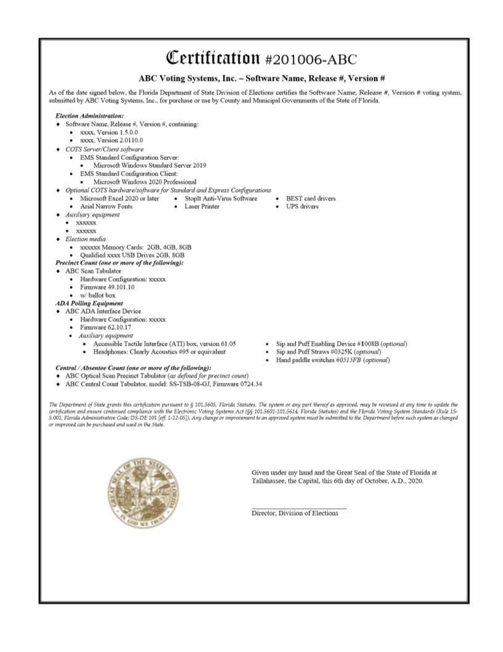
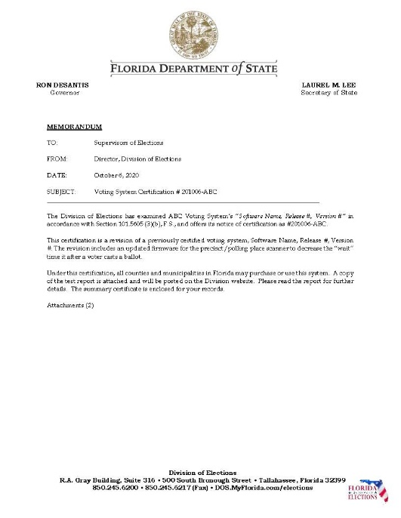
Approval and Certification

Slide 9
Certified Voting Systems in Florida

Slide 10
Florida Certified Voting Systems
Escambia
Holmes
Escambia
Santa Rosa
Okaloosa
Jackson
Walton
Washington
Gadsden
Jefferson
Nassau
Calhoun
Leon
Jefferson
Madison
Hamilton
Duval
Bay
Suwannee
Columbia
Baker
Liberty
Wakulla
Taylor
Gulf
Franklin
Lafayette
Union
Bradford
Clay
St. Johns
Dixie
Gilchrist
Alachua
Putnam
Levy
Flagler
Marion
Volusia
Volusia
Citrus
Lake
Sumter
Seminole
Hernando
Orange
Brevard
Voting Systems by Vendor
18 | Dominion – Democracy Suite
49 | ES&S – EVS
Pasco
Hillsborough
Polk
Osceola
Pinellas
Indian River
Manatee
Hardee
Okeechobee
Highlands
St. Lucie
Sarasota
DeSoto
Martin
Charlotte
Glades
Lee
Hendry
Palm Beach
Collier
Broward
Monroe
Dade

Slide 11
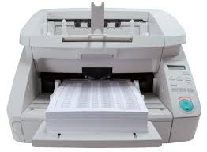
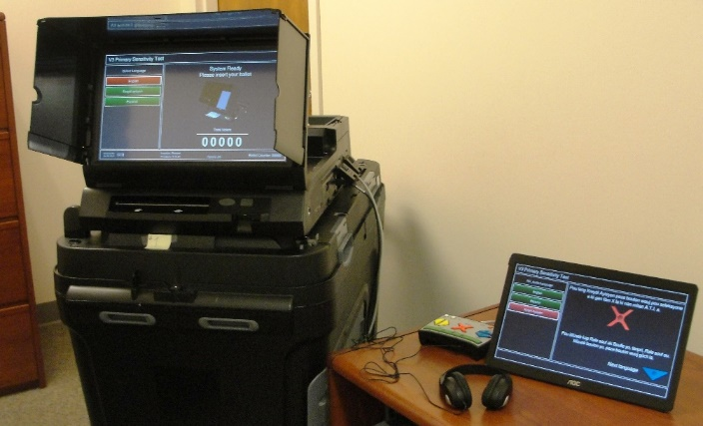
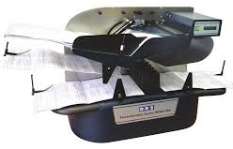
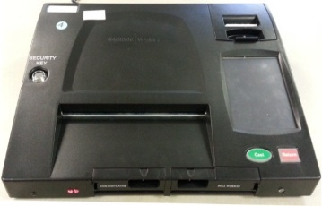
Florida Certified Voting Systems
Dominion Voting System – Democracy Suite
ImageCast Central (ICC)
ImageCast Evolution (ICE)
Precinct/Polling Place and ADA Scanner
Central Count scanners
DRS Photoscribe
ImageCast Precinct (ICP)
Precinct/Polling Place Scanner

Slide 12
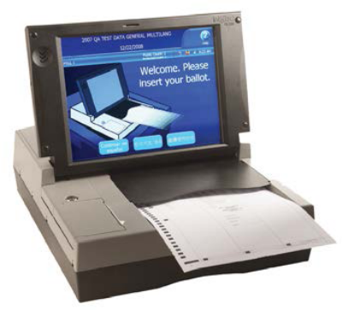
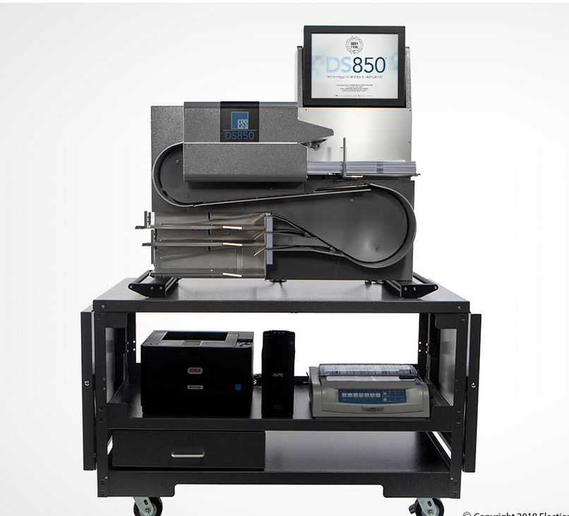
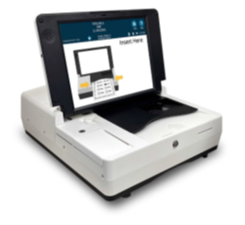
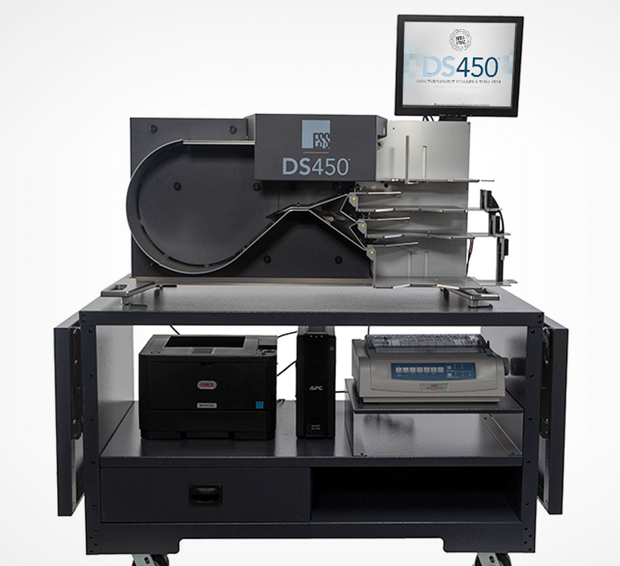
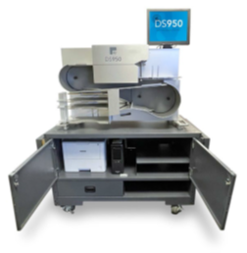
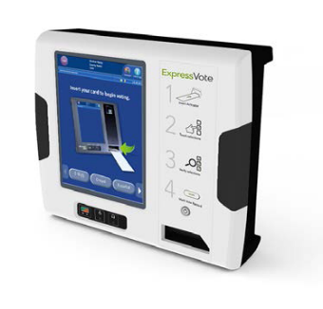
Florida Certified Voting Systems
Elections Systems & Software – EVS
DS200
DS850 & DS450 & DS950
Precinct/Polling Place Scanner
DS300
Central Count Scanners
ExpressVote
ADA Voter Interface Device

Slide 13
Testing non-voting systems

Slide 14
Automated Independent Audit System
      s. 101.591, FS
      Rule 1S-5.026 (last revised 06/2022)
      DS DE 105B Manual Audit Team Worksheet - Marksense Ballots
      DS DE 106 - Precinct Summary- Manual Audit
      DS DE 106A Precinct Summary- AIA
      DS DE 107 Voting Systems Audit Report
      DS-DE 410 Procedures Manual for Post-Election Certification Voting System Audits

Slide 15
Independent Recount Tabulation System
  ss. 102.141, 102.166, FS
  Rule 1S-2.031, Fla. Admin. Code (last revised 06/2022)
  DS-DE 405 Recount Procedures Manual
  No system yet approved in Florida

Slide 16
Statutory reporting and testing requirements

Slide 17
Logic and Accuracy Testing
Pre-election

Slide 18
L&A Election Results XML Report
All (100%) electronic/electromechanical voting systems to be used in an election must undergo logic and accuracy testing to ensure that the system is properly programmed, the election is accurately defined, and the input, output, and communication devices are functioning properly.
A random selection of at least 5% or 10 precinct optical scan devices must be publicly tested (whichever is greater) and it would be a best practice to also include the voter interface devices, which are accessible for ADA voters.
      When testing is complete, SOE should submit an election summary results XML file to the SOE File Transfer Utility and, within 24 hours of the public test, an election database “backup.”

Slide 19
Official Results Database

Slide 20
Official Elections Results Database
      At the same time that the official results are certified by the county (to the state), a copy of an export file from the elections results database.
      This submission can be the database itself or the precinct-level results file will fulfill this requirement.

Slide 21
Precinct-Level Election Results
Post-election

Slide 22
County Statutory Election Reporting Requirements
(to BVSC)
    Precinct-Level Election Results
      This file is created using a utility software that resides on the voting system’s election management server. Make sure you have the correct utility software loaded.
      Submittal is required within 10 days after certification of a Presidential Preference Primary Election, Special Election, Primary Election, or General Election by the Elections Canvassing Commission.
      County data is compiled in order to comply with the requirement that precinct-level election results be made available to the both the Legislature and the public in a uniform, searchable, sortable, electronic format.

Slide 23
Conduct of Elections Reports
Post-election

Slide 24
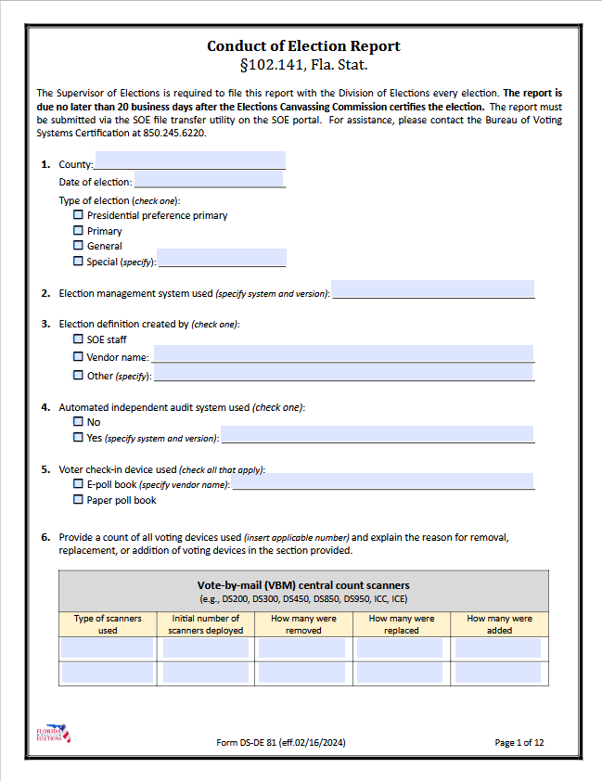
County Statutory Election Reporting Requirements
(to BVSC)
  Conduct of Elections Report
Form (DS DE-81) on Division of Elections’ forms webpage
Must be file same time as official election results filed/certified.
Report is basis for discovering difficulties that were encountered in the election for purpose of proactively implementing possible solutions to these problems for future elections.
Basis for legislative report due February 15, of each year following General Election

Slide 25
Overvote and Undervote Report
Post-election

Slide 26
Form – DS-DE 40 Overvotes/Undervotes
By December 15th of a General Election year, Supervisors must submit a report including the total number of overvotes and undervotes cast for the “President / Vice President” or the “Governor / Lt. Governor” contest or, if neither appears, the first race appearing on the ballot.
County data submitted on form DS DE-40
  Five sections
  Analyzed and compiled into a report
  Basis for legislative report due February 15, of each year following General Election

Slide 27
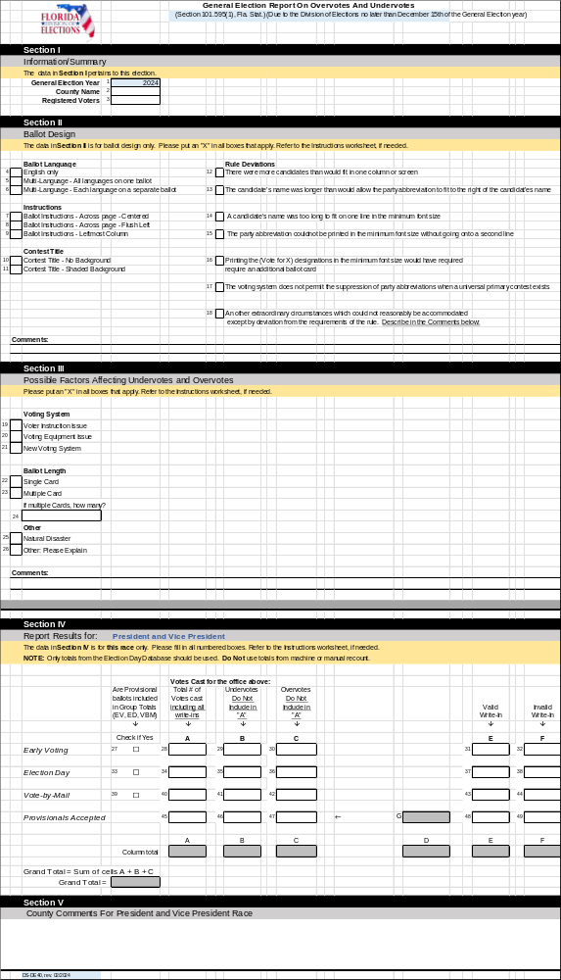
Form – DS-DE 40 Overvotes/Undervotes

Slide 28
Purpose of Report
The purpose is to:
Detect problems with ballot design or instructions that might have caused voter confusion, voting system problems, and
Identify recommendations for correction of such problems, if they exist.

Slide 29
Voting System Audit Report
Post-election

Slide 30
Post-Election Certification Voting System Audit
Publicly noticed – 24 hours before activity begins.
Must be completed and posted no later than the 7th day after an election has been certified and the report is due to the BVSC by December 15th.
Basis for legislative report due February 15, of each year following General Election
Manual or Automated (audit criteria is based on audit type).
Full procedures and required forms for conducting the audit may be found in Rule 1S-5.026, F.A.C. on the Division’s website.

Slide 31
Procedures Manual and Forms
DS-DE 105
DS-DE 106
DS-DE 106
DS-DE 107
Precinct summary
Manual Audit Team Worksheet
Precinct summary –discrepancy sheet
Voting Systems Audit Rpt
DS-DE 410
See Rule 1S-5.026, F.A.C. on the Division’s website.

Slide 32
Minimum Security Procedures
Annual and upon update

Slide 33
County Statutory Election Reporting Requirements
(to BVSC)
  Minimum Security Procedures
Security procedures ensure that the county has adequate safeguards for their ballots, voting system, and facilities.
Requirements for what needs to be included in procedures are found in Rule 1S-2.015, F.A.C. on the Division’s website.
Rule currently under revision
Security procedures are submitted whenever the county changes their processes and are required no later than 45 days before Early Voting commences
or as a result of an emergency situation that happens within the 45 day window.

Slide 34
County Statutory Election Reporting Requirements
(to BVSC)
  Bi-ennial Review of County Minimum Security Procedures
BVSC conducts a review in odd-numbered years and any time security procedures edits are submitted.
After the review is complete, a checklist of compliant/noncompliant items is provided to the county.

Slide 35
Voting Systems Acquisition Report
County statutory reporting requirement

Slide 36
Report Form
The acquisition form is sent from BVSC, along with the voting system installation disks.
2 part form:
1. General voting system information.
2. A checklist for verified installation of the items for a certified voting system.
  The Supervisor of Elections is required to provide an updated voting system acquisition report whenever there is a change or update to the voting system.

Slide 37
Purchase/sale/disposition
Purchase
  County only
  Competitive bid with emergency situation exception
  Notice to Division
Sale
  Notice to Division with certification that sale will not impact Supervisor conduct of elections
  Division notice to other SOEs about availability of equipment (if still certified/approved and usable)
Disposition/destruction
  Best practices – U.S. Election Assistance Commission
https://www.eac.gov/faq/we-are-replacing-computersvoting-equipment-and-dont-know-what-do-old-ones-can-we-sell-them-what

Slide 38
Election Observations
Unofficial and official

Slide 39
Election Observations
    Two types: Unofficial (Routine) and Official
    Deputy (BVSC) is appointed to observe county election activities.
    Deputy must have access to county offices, early voting sites, Election Day precincts, canvassing board room, tabulation and/or ballot process areas, as well as any areas or procedures, records, or items relating to the election in order to sufficiently observe voting processes.
    Counties are notified in advance of visit.
    Deputy to observe various activities, but may not interfere with voters or voting in any way.
    During an official observation, the Deputy cannot discuss findings with SOE staff.

Slide 40
Election Observations - Unofficial
    Deputy (BVSC) is appointed and deployed by DOS/Secretary of State statewide during the election cycle to conduct “unofficial” election observations to observe county processes and procedures, to assess voter turnout, and to assist as ‘boots on the ground’ if needed.
    BVSC conducts observations of logic & accuracy testing, early voting and Election Day/Night activities, including tabulation, accumulation, and processing of voted ballots.
    During a routine observation, SOE staff may view, copy, or discuss the Deputy’s observations.
    No findings or official report

Slide 41
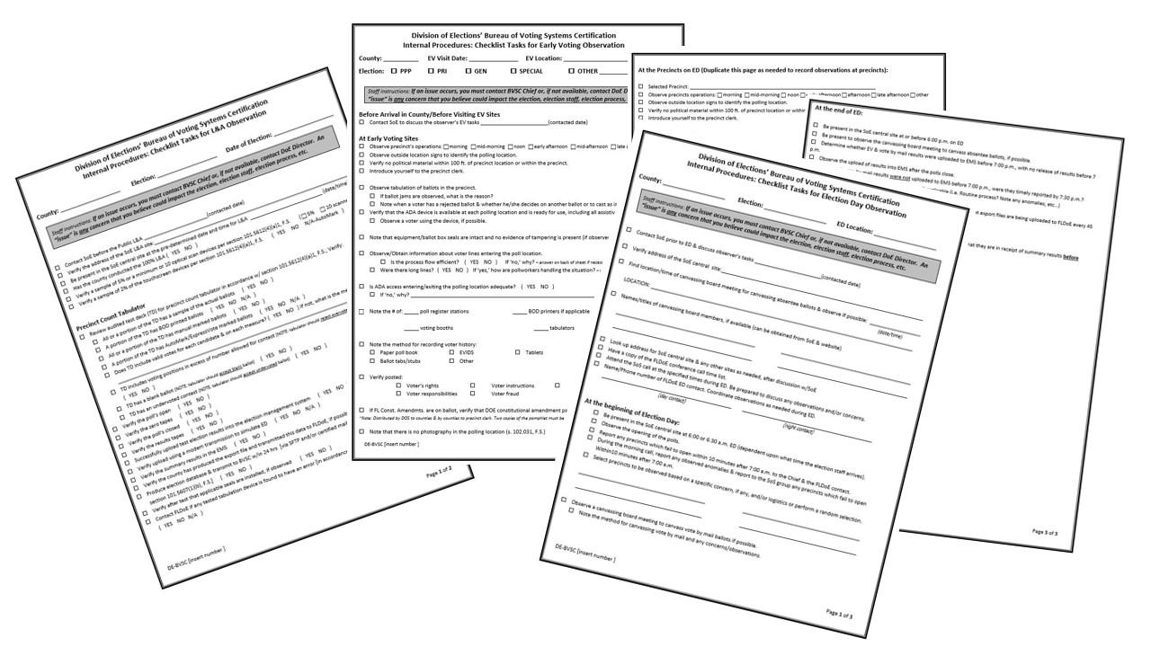
Election Observations – Unofficial (cont’d)
    BVSC uses a checklist for each type of activity to ensure that the same standards are being applied throughout the state.

Slide 42
Election Observations - Unofficial
    If a Deputy observes isolated issues at an early voting site or Election day polling location, he/she will speak with the precinct clerk or assistant clerk, if possible, to get the problem corrected immediately.
EXAMPLES:
    Voter rights/responsibilities aren’t posted at a site; the poll deputy isn’t ensuring that there is no solicitation occurring within the 150 foot zone, etc.
If a Deputy finds systemic issues, he/she will notify the SOE office.
EXAMPLES:
Voter rights/responsibilities/fraud number aren’t posted or secrecy sleeves aren’t being offered at any site visited.

Slide 43
Rules
And forms

Slide 44
Rules
Rules that BVSC provide input or have related duties
1S-2.004 | Purchase, Sale, and Uses of Voting Equipment and Systems | 1/2/2012
1S-2.015 | Minimum Security Procedures for Voting Systems | 4/1/2016
1S-2.027 | Standards for Determining Voter Intent | 8/8/2024
1S-2.028 | State Write-in Ballot | 12/9/2003
1S-2.030 | Vote-by-Mail Ballots for Absent Stateside Uniformed Services and Overseas Voters | 2/13/2020
1S-2.031 | Recount Procedures | 6/27/2022
1S-2.032 | Uniform Design for Election Ballots | 4/23/2020
1S-2.034 | Polling Place Procedures Manual | 7/31/2024
1S-2.037 | Provisional Ballots | 4/13/2022
1S-2.051 | Standards for Determining Voter's Choice on a Federal Write-In Absentee Ballot | 8/23/2015
1S-2.053 | Election Results, Precinct-Level Election Results, Voting History, and Reconciliation Reporting | 7/1/2017
1S-2.054 | Poll Watcher Designation Form | 8/8/2016
1S-5.001 | Voting System Equipment Regulations | 1/12/2005
1S-5.026 | Post-Election Certification Voting System Audit | 6/27/2022

Slide 45
Contact information

Slide 46
Bureau of Voting Systems Certification
Phone Number: 850.245.6220
Email: BVSC.Reports@dos.myflorida.com (voting systems inquiries only)
Fax Number: 850.245.6236
Linda.hastings@dos.fl.gov
Zane.wood@dos.fl.gov

Slide 47
Questions?

Slide 48

FLORIDA
DEPARTMENT
of STATE
For more information, visit us online at:
dos.myflorida.com/elections/

